Slide 1

The Healthy Table
Final Project for CSYE 6220
Shuaibo Gao
gao.shua@husky.neu.edu
NUID: 001725554

Slide 2


The Problem?
Knowing what to eat can be confusing
Have no ideas about what is or is not good for us
Not able to track calorie taken in every day
No way to order healthy food online with clear health information. Yelp? Unfortunately, it doesn’t!
Restaurant have no channel to push their healthy food

Slide 3

What is the Solution?
The Healthy Table provides you dinning recommendations
The Healthy Table tells you what is the best for you by using a health formula
The Healthy Table can track the calorie every day for you
The Healthy Table can give a clear calorie for each dishes
The Healthy Table help healthy restaurant attract customer who want healthy food

Slide 4
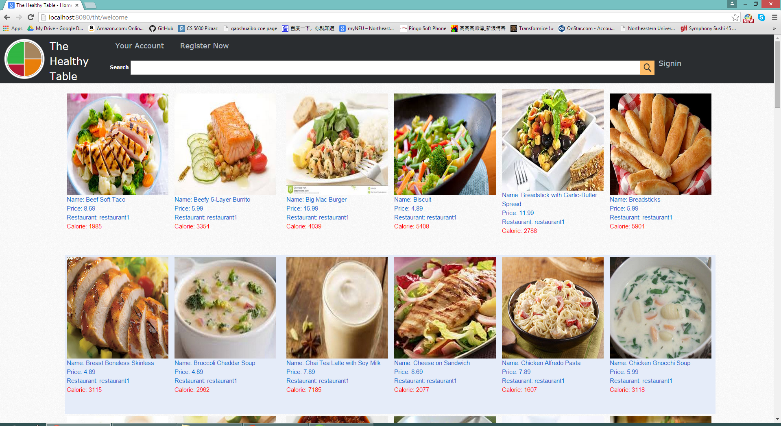
User Interface
Clear
Attractive
Information
Filter

Slide 5
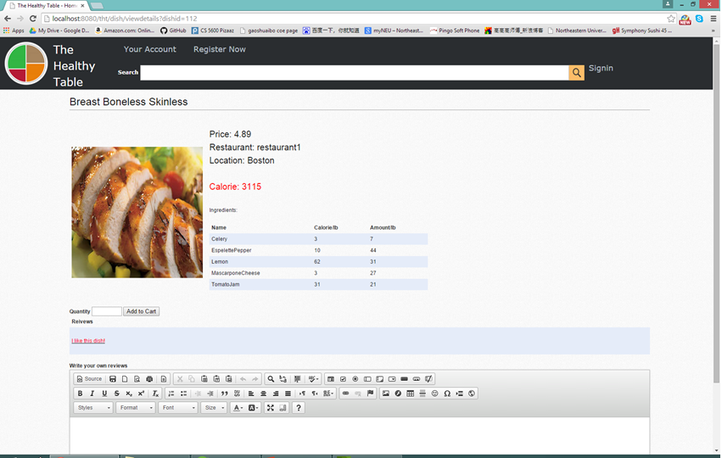
Dishes Information
Detailed
Calories
Ingredient
Amount
Image

Slide 6
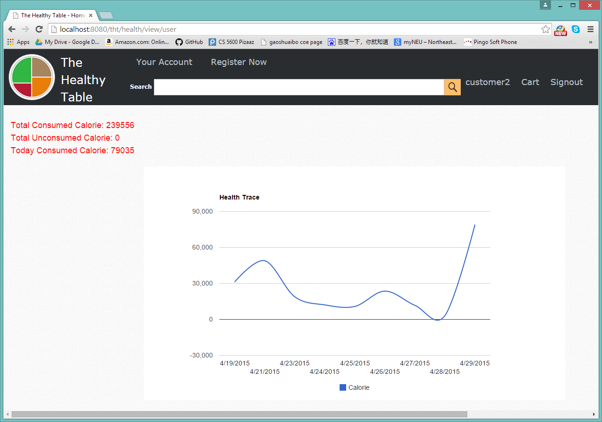
Graphic Calorie Tracker
Every Day
Chart
Accurate
Clear

Slide 7
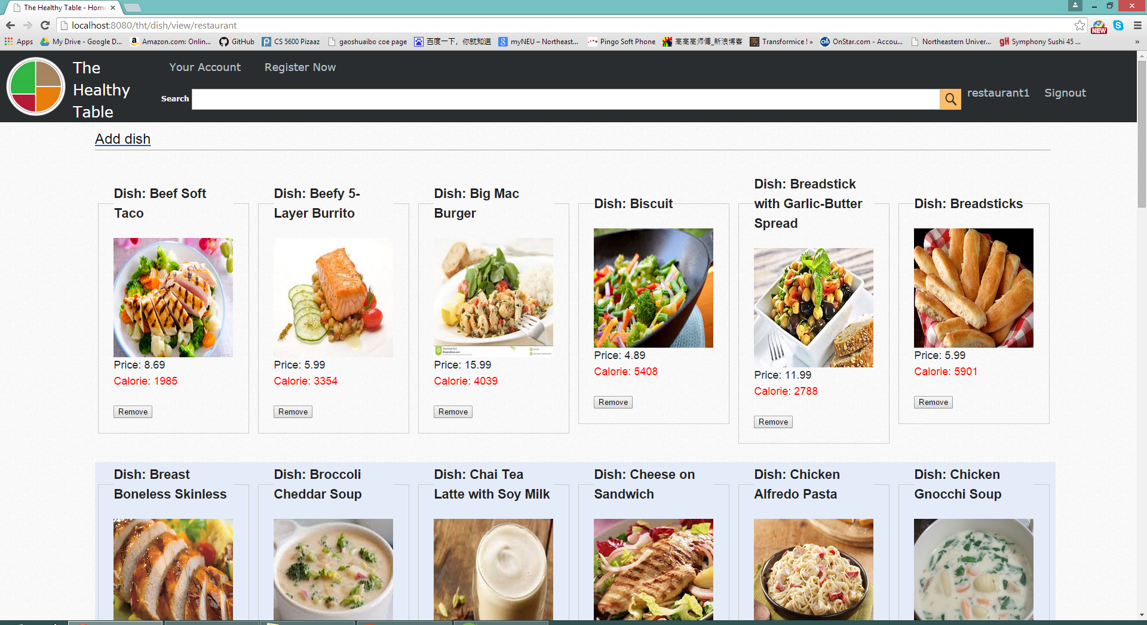
Restaurant Menu
Detailed
Image
Ingredient
Amount

Slide 8
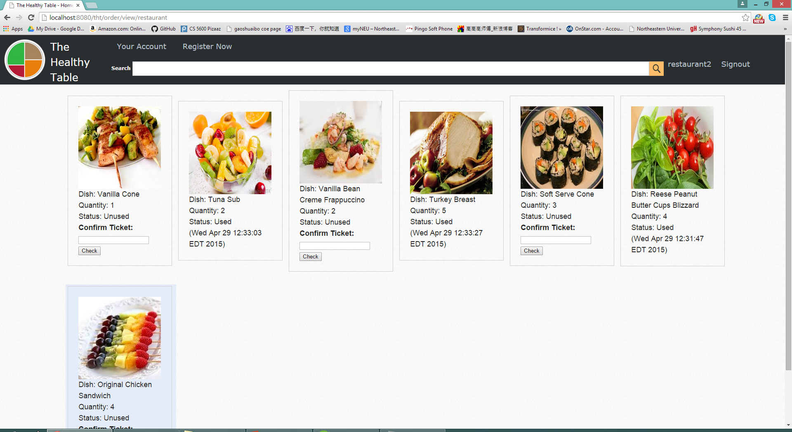
Consume at Restaurant
Ticket
Code
Order
Confirm

Slide 9
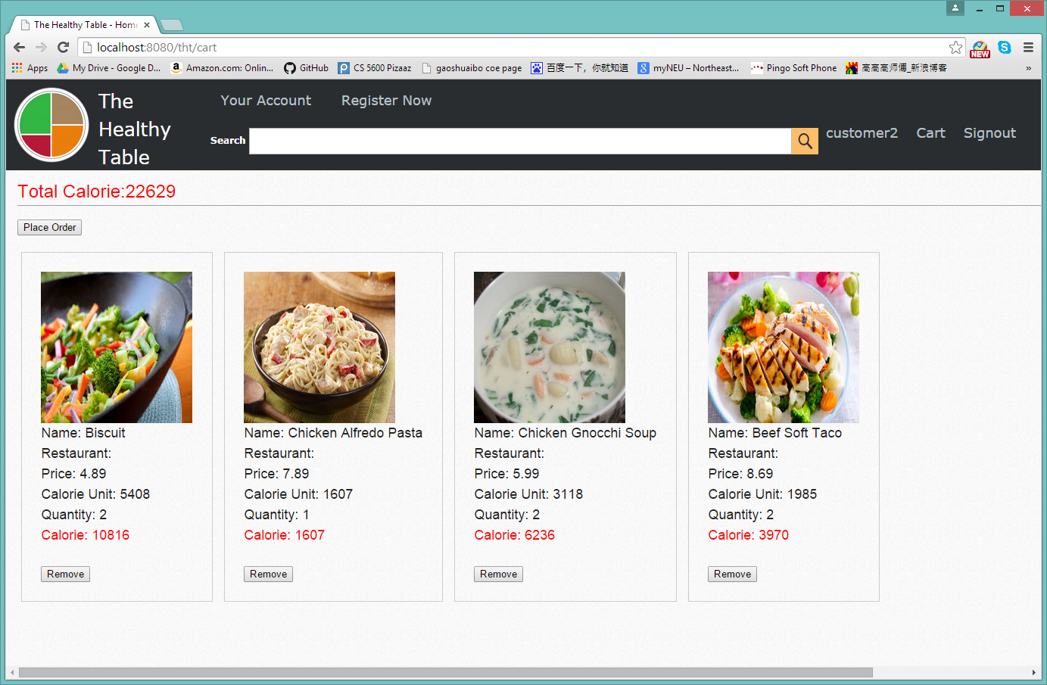
Cart
Total Calorie
Each Calorie
Calorie Unit

Slide 10
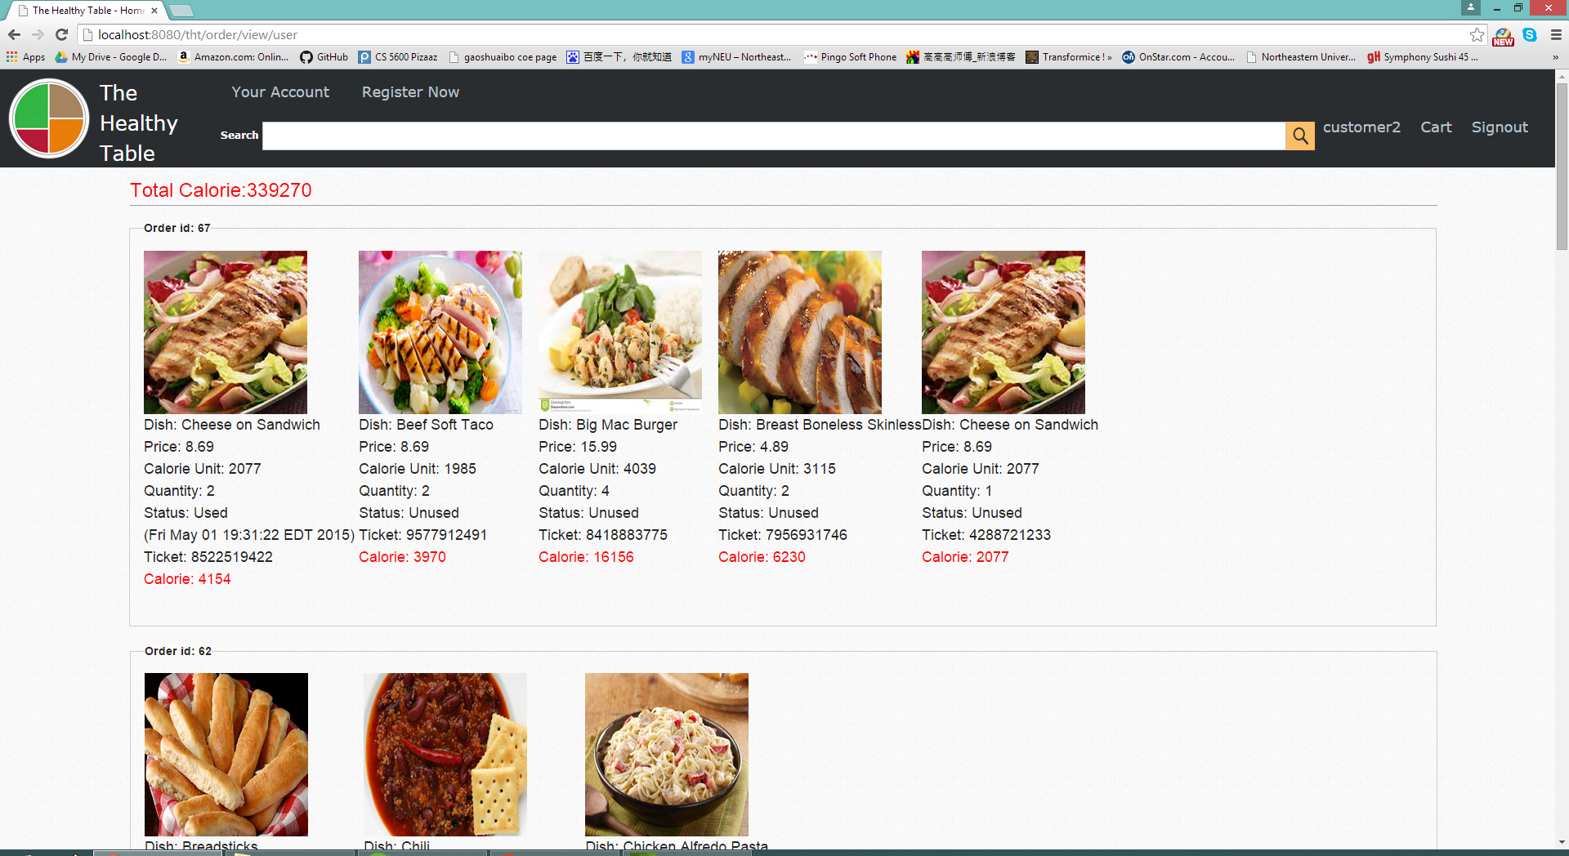
Customer Order
Total Calorie
Each Calorie
Unit Calorie
Ticket
Status
Consume Time

Slide 11
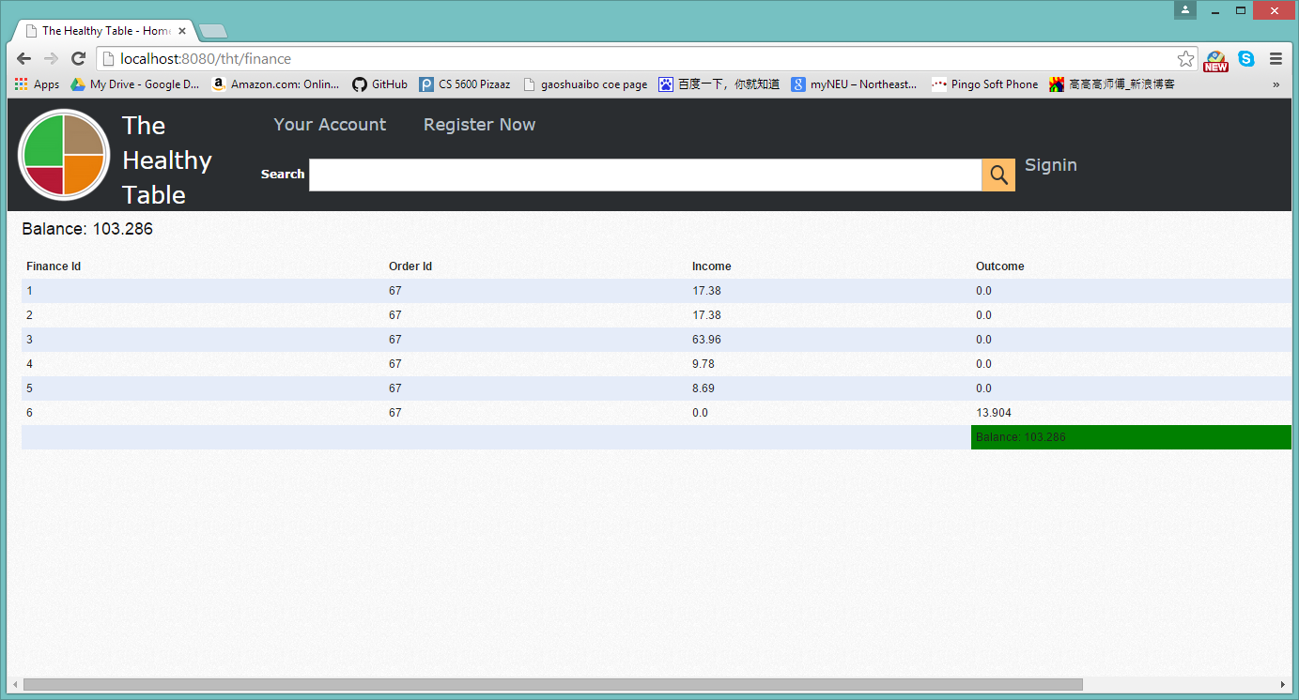
System Finance Report
Every Payment
Income
Outcome
Balance
Time Stamp

Slide 12
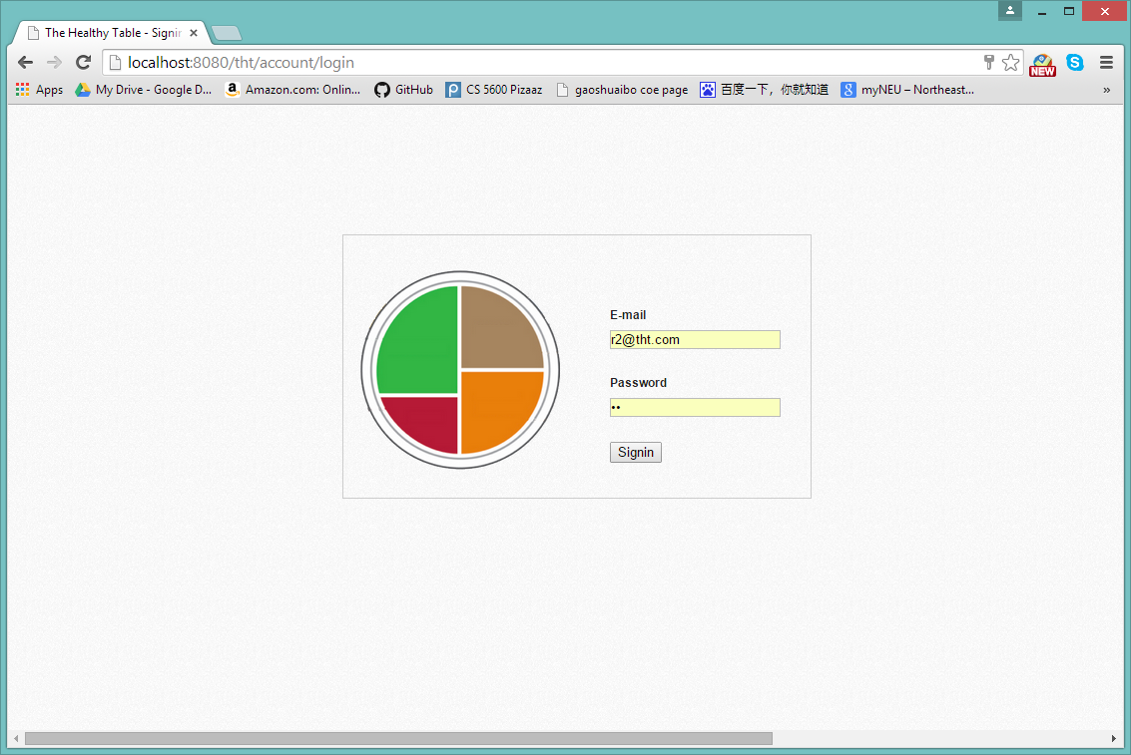

Sign Up / Sign In
Easily Register
Simple Login
Customer
Restaurant

Slide 13
Right at The Healthy Table
Final Project for CSYE 6220
Shuaibo Gao
gao.shua@husky.neu.edu
NUID: 001725554

